Slide 1
Writing Chinese Characters eLearning Module
歡迎
Steven A. Naisbitt

Slide 2


Welcome!
This might seem overwhelming, especially as you look at the following Chinese character:
我
Through this eLearning module, we’re going to learn about how to write traditional Chinese characters.

Slide 3

Welcome!
我
Which stroke do you do first?
Which direction do you make the stroke?
Can someone really tell if you write the stroke incorrectly?
Let’s see if we can answer these questions. Click the arrow to continue.

Slide 4

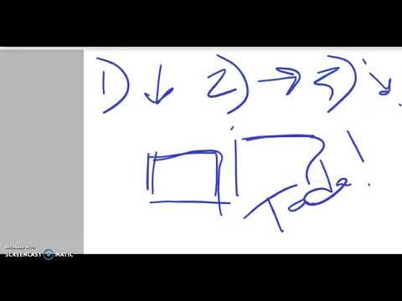

Let’s first start with three very basic rules of writing a Chinese character. We will use the character “口” (kou), meaning mouth, to teach these three rules.
Please click on the video below to understand these three rules.

Slide 5


Time-Out!
Which of these is the first basic rule for writing a Chinese character:
Let’s now see how well you remember these three basic rules for writing traditional Chinese characters…
1. You draw the character from bottom to top.
2. You draw the character from right to left.
3. You draw the character from left to right.

Slide 6

Are you sure that is the best answer? You may want to re-watch the video, and try again.
1. You draw the character from bottom to top.
2. You draw the character from right to left.
3. You draw the character from left to right.

Slide 7

That is correct!
3. You draw the character from left to right.

